Slide 1
物聯網實務 HW10
電機碩一 11278008 林佳慧
日期:2023/11/22

Slide 2
Exercise 10-1
Create a project

Slide 3
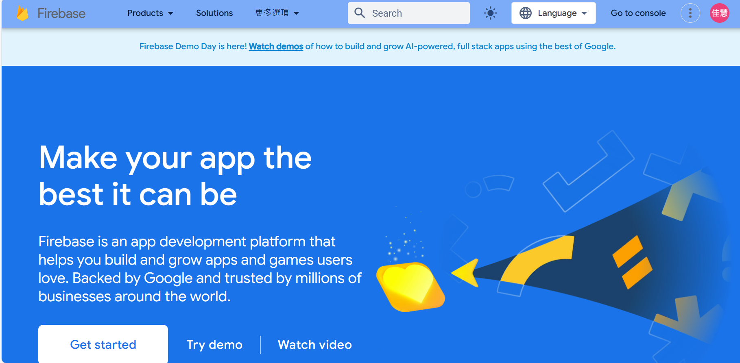
Firebase
https://firebase.google.com/

Slide 4
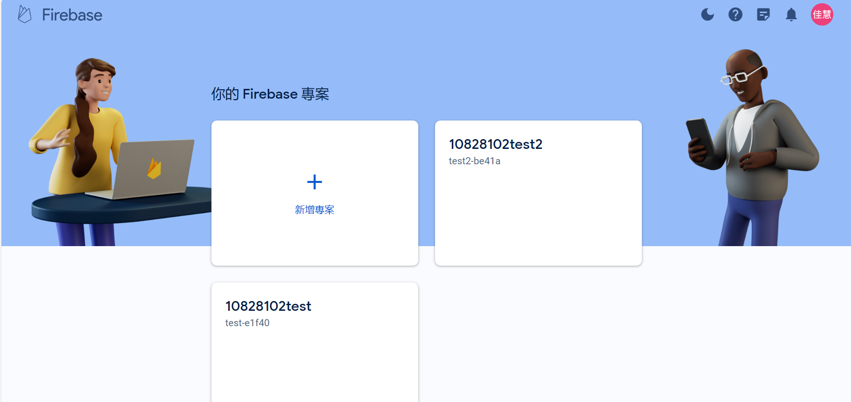
Create a project

Slide 5
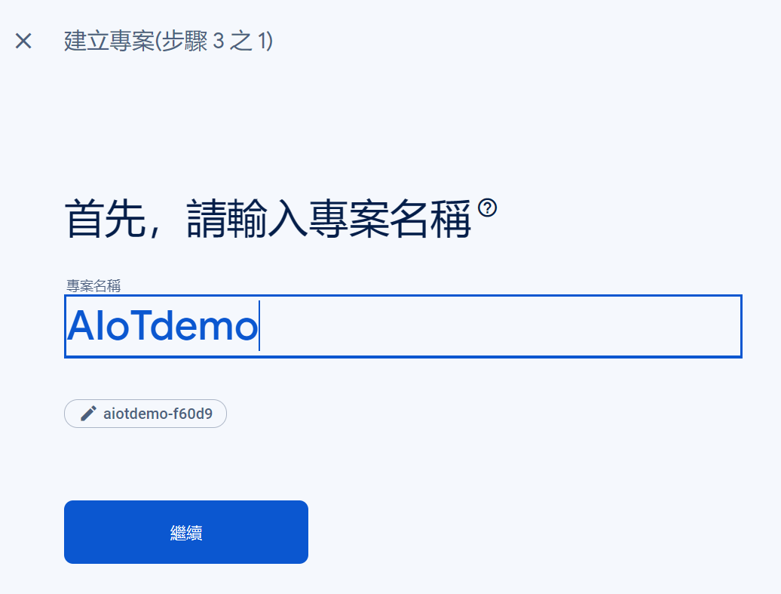

Slide 6
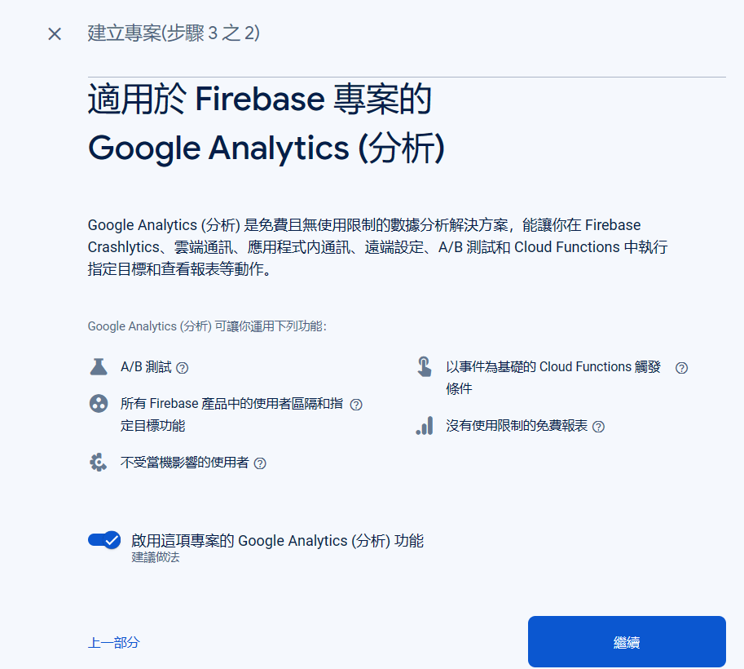
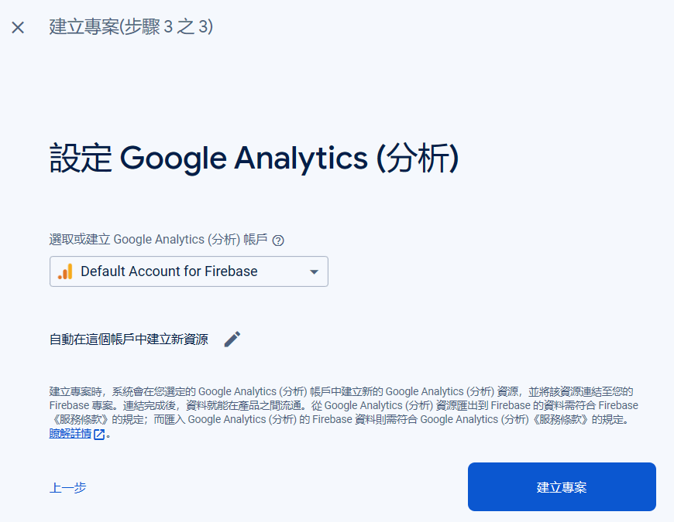
Analytics

Slide 7
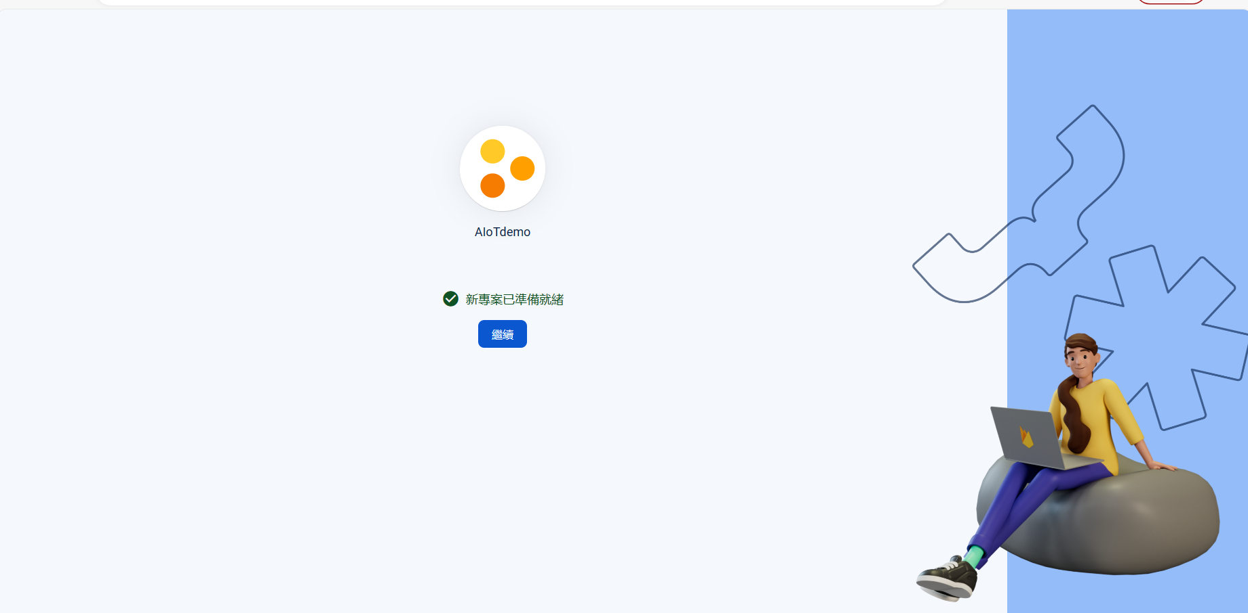
Your new project is ready

Slide 8
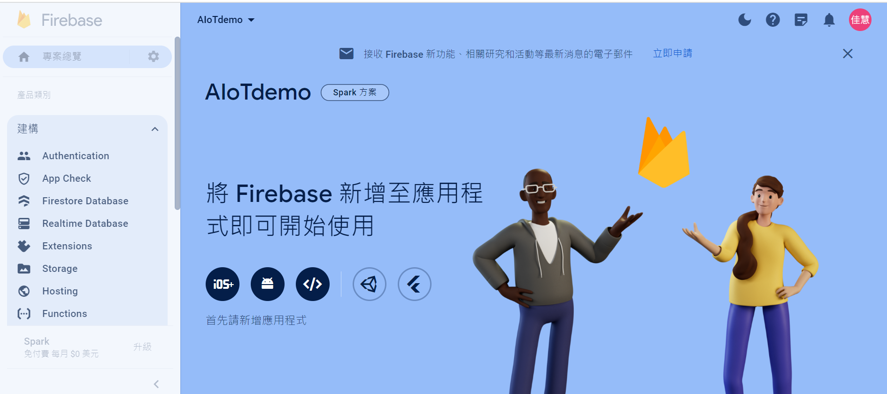
Project Desktop

Slide 9
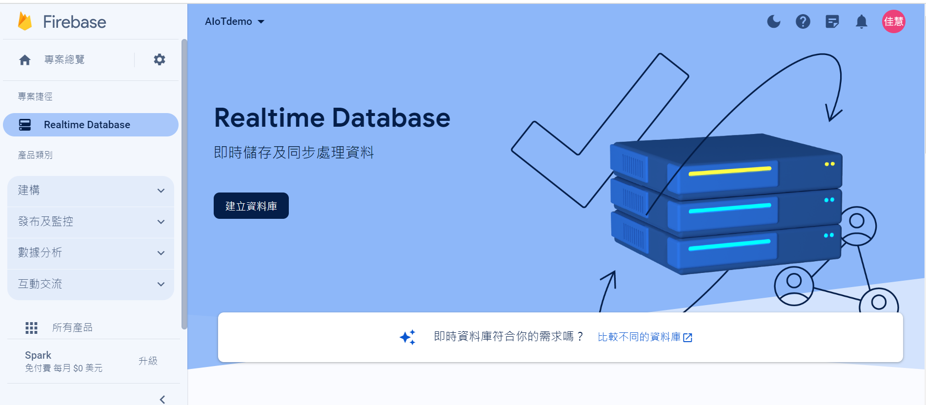
Create Database

Slide 10
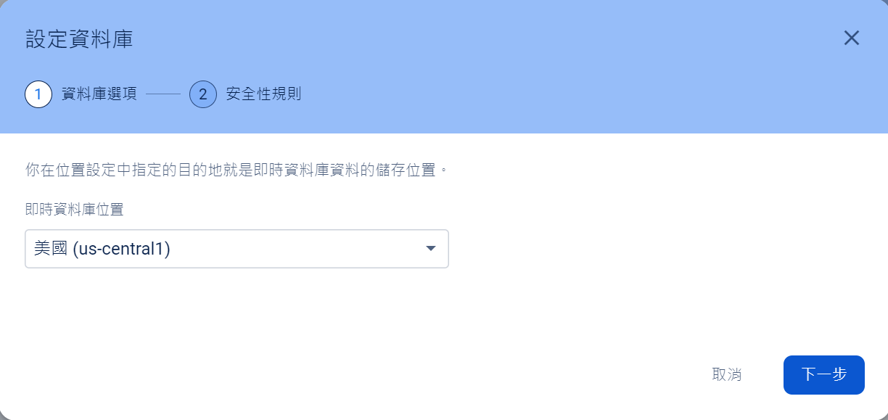
Set up database

Slide 11
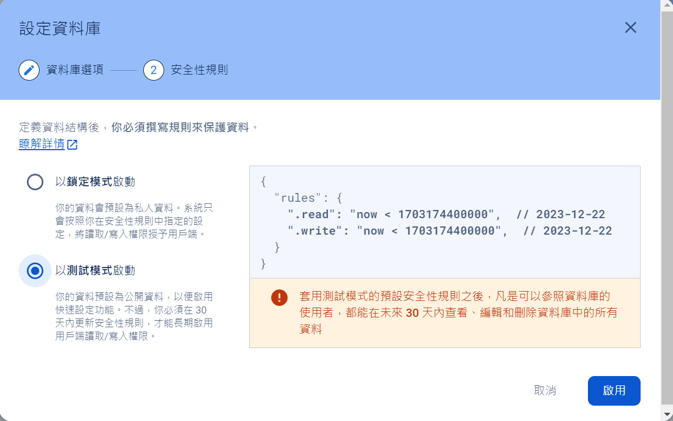
Start in test mode

Slide 12
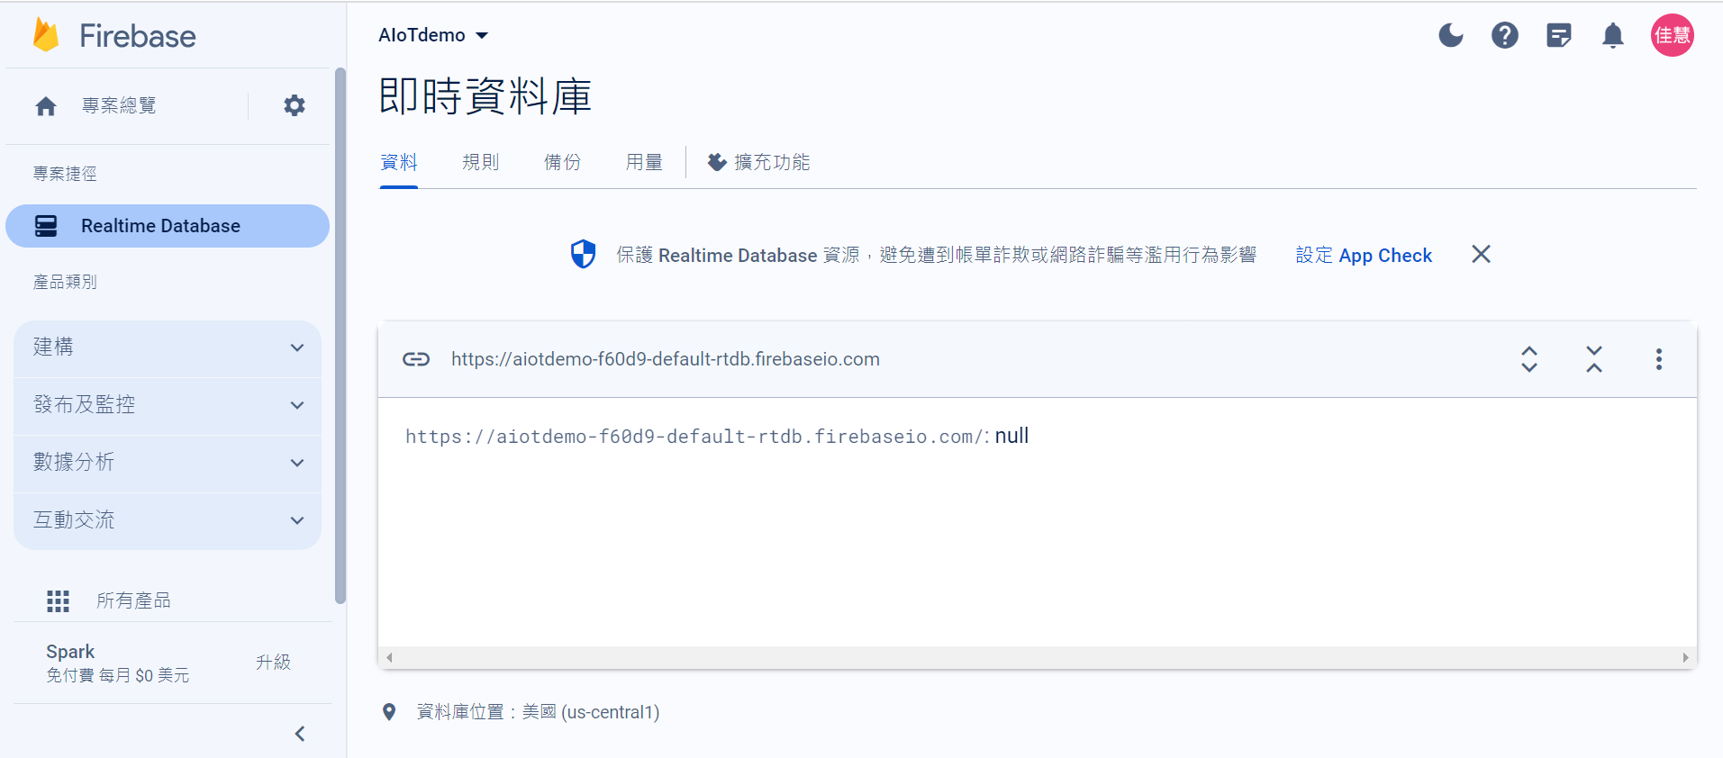

Slide 13
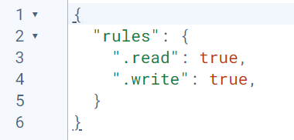
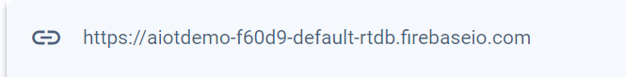
Copy reference url
Setup the rules and Publish
Copy reference url

Slide 14
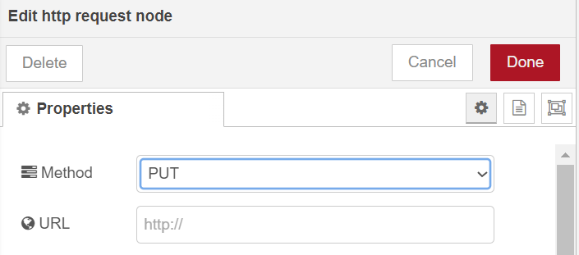
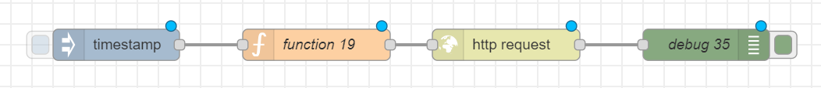
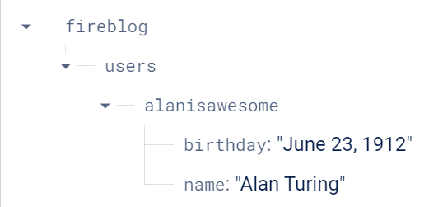
3. Done
1. Double click
Your url
2. PUT
msg.url="https://aiotdemo-f60d9-default-rtdb.firebaseio.com/fireblog/users.json";
msg.payload={"alanisawesome": {"name": "Alan Turing", "birthday": "June 23, 1912"}};
return msg;

Slide 15
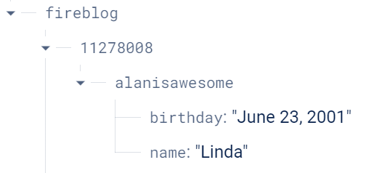
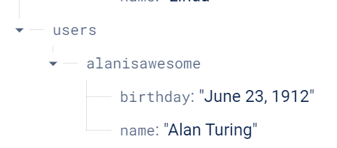
Change -> Deploy -> Triger
Student ID
msg.url="https://aiotdemo-f60d9-default-rtdb.firebaseio.com/fireblog/11278008.json";
msg.payload={"alanisawesome": {"name": "Linda", "birthday": "June 23, 2001"}};
return msg;
Name

Slide 16
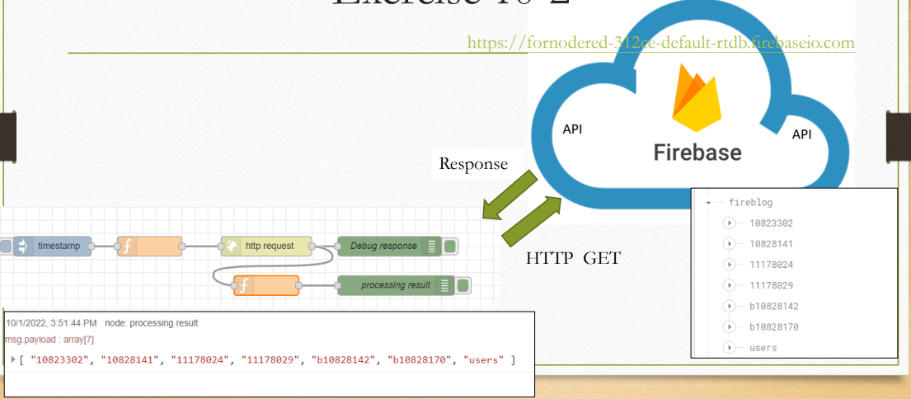
Exercise 10-2

Slide 17
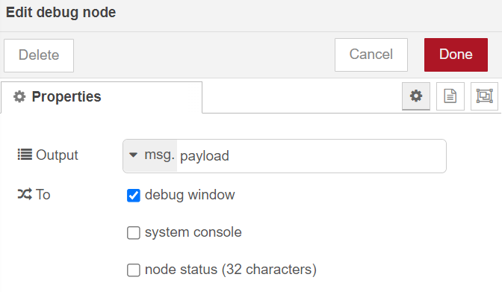
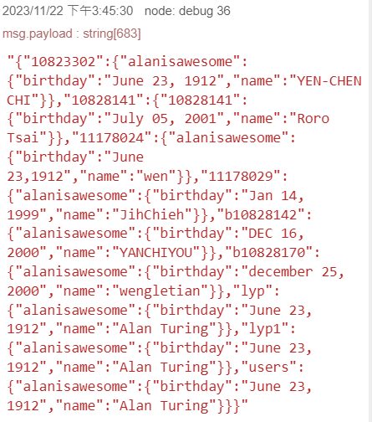
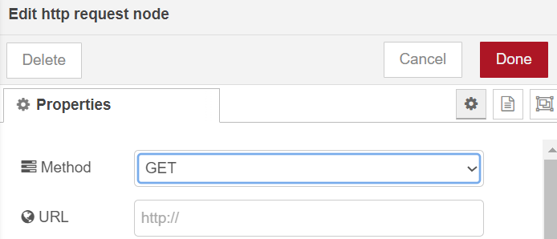
http GET
msg.url ="https://fornodered-312ce-default-rtdb.firebaseio.com/fireblog.json";
return msg;

Slide 18
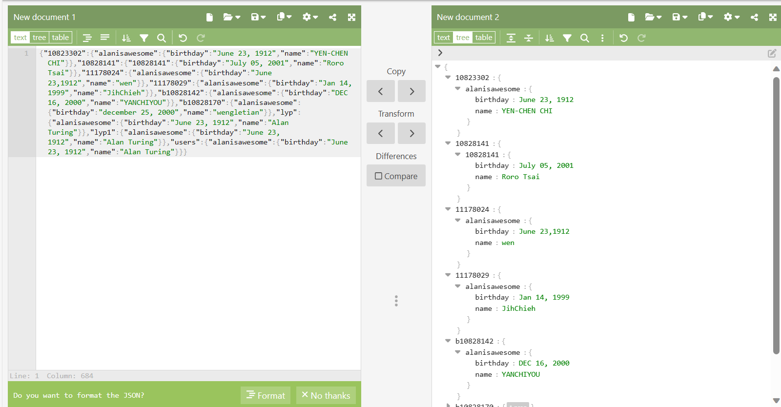
Observe the data
https://jsoneditoronline.org/#left=local.domori&right=local.xogeva

Slide 19
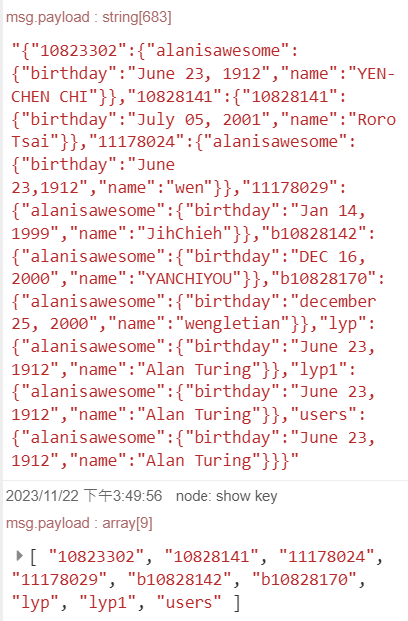
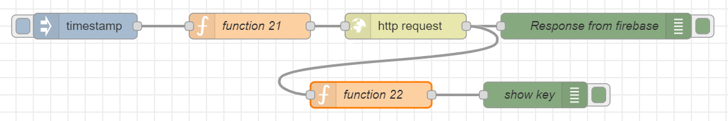
Set URL
HTTP GET
click
var result= msg.payload;
var obj=JSON.parse(result);
msg.payload=Object.keys(obj);
return msg;
Processing the response

Slide 20
Exercise 10-3
Node-Red module for interacting with Firebase

Slide 21
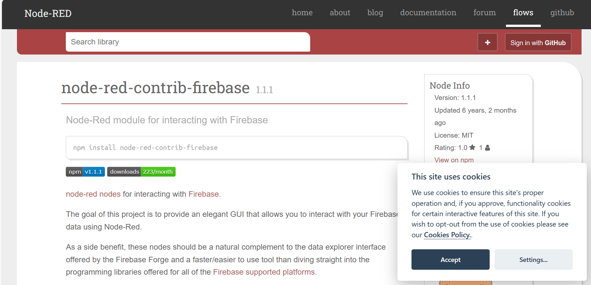

Slide 22
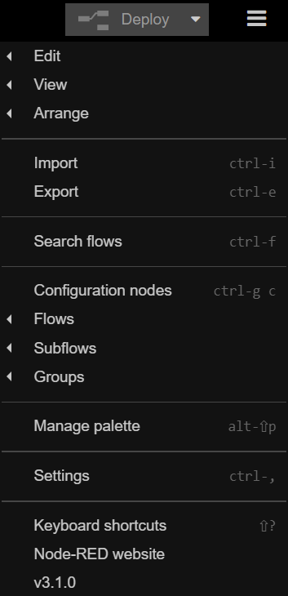
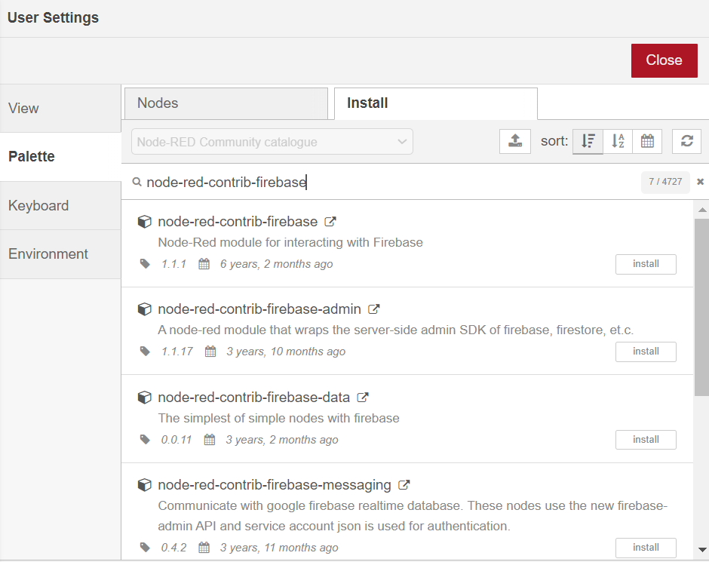
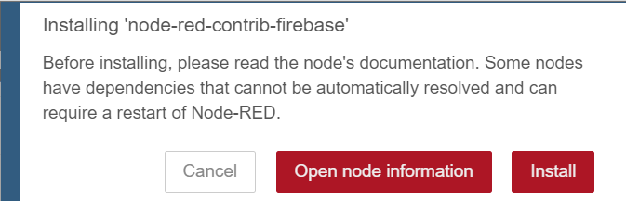
3. install
1
4. node-red-contrib-firebase
5
2
6

Slide 23
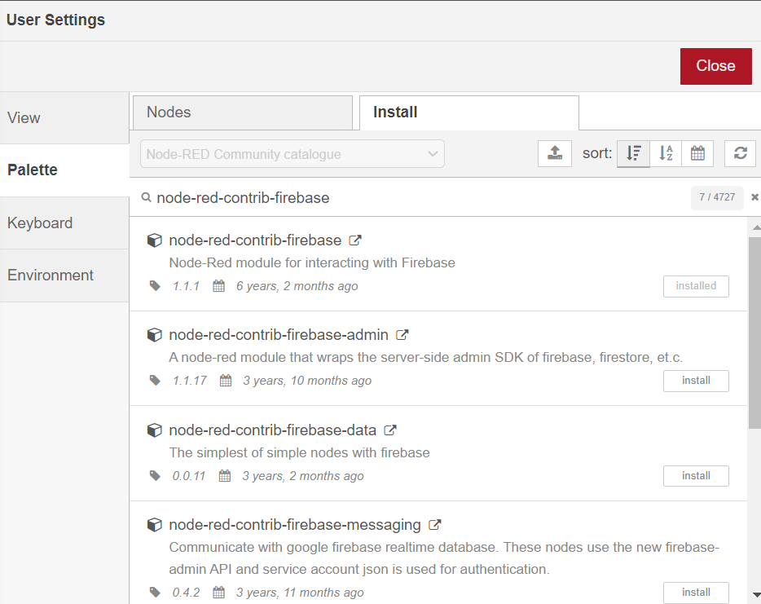
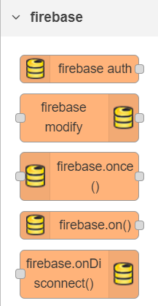
close

Slide 24
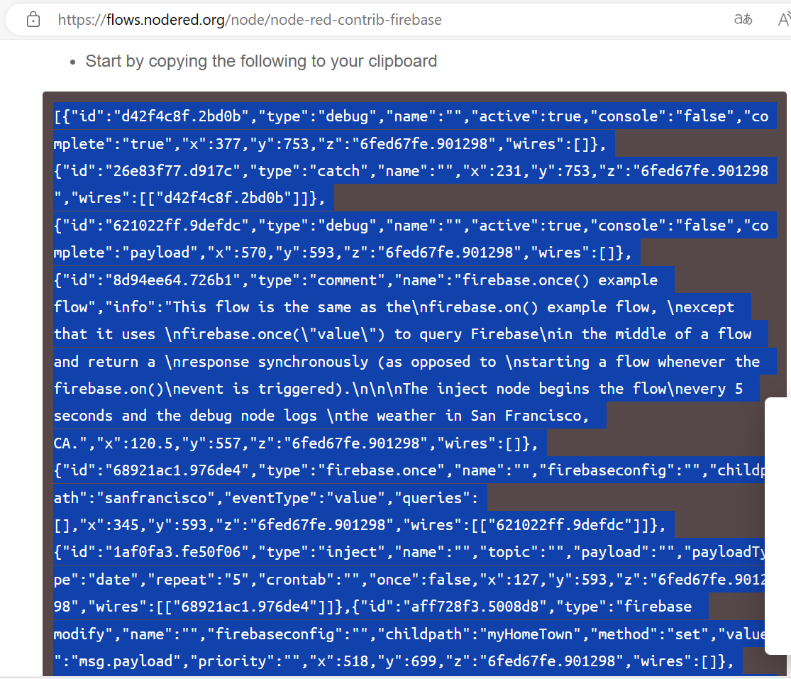
https://flows.nodered.org/node/node-red-contrib-firebase
Copy

Slide 25
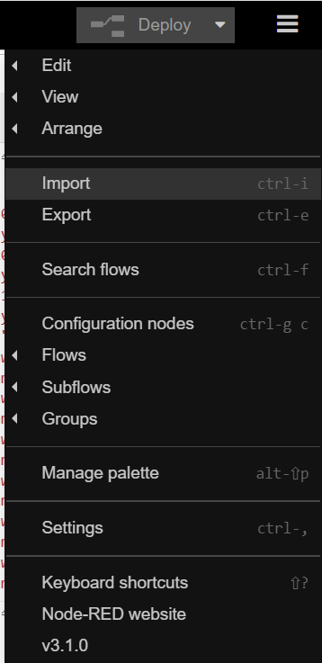
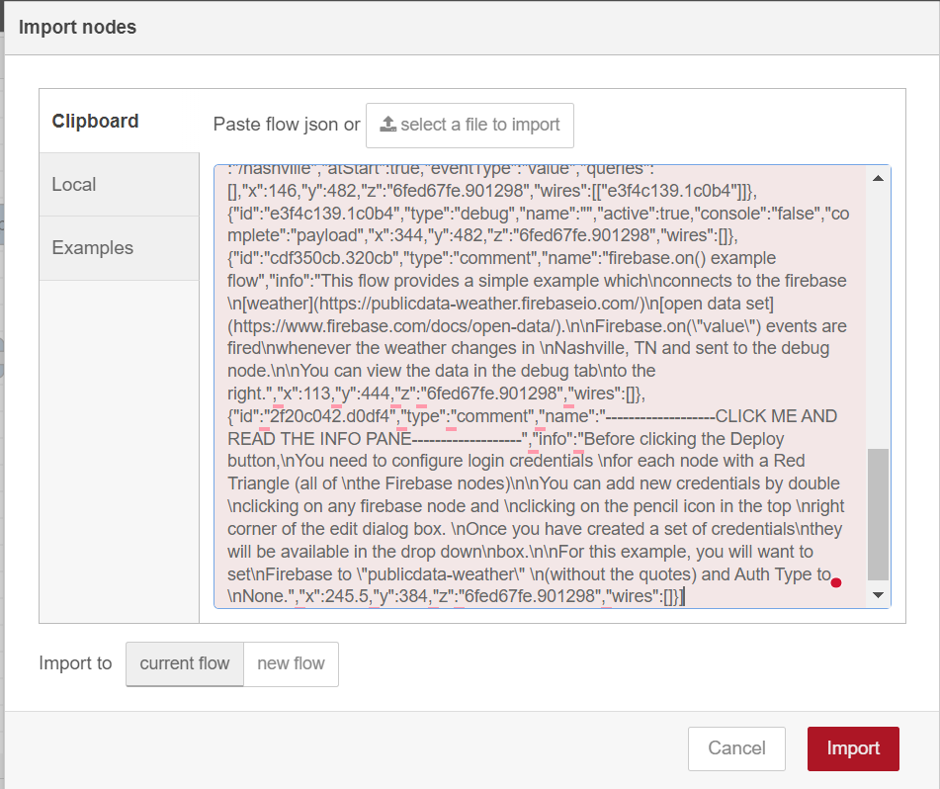
Import>Clipboard
1
2
Paste

Slide 26
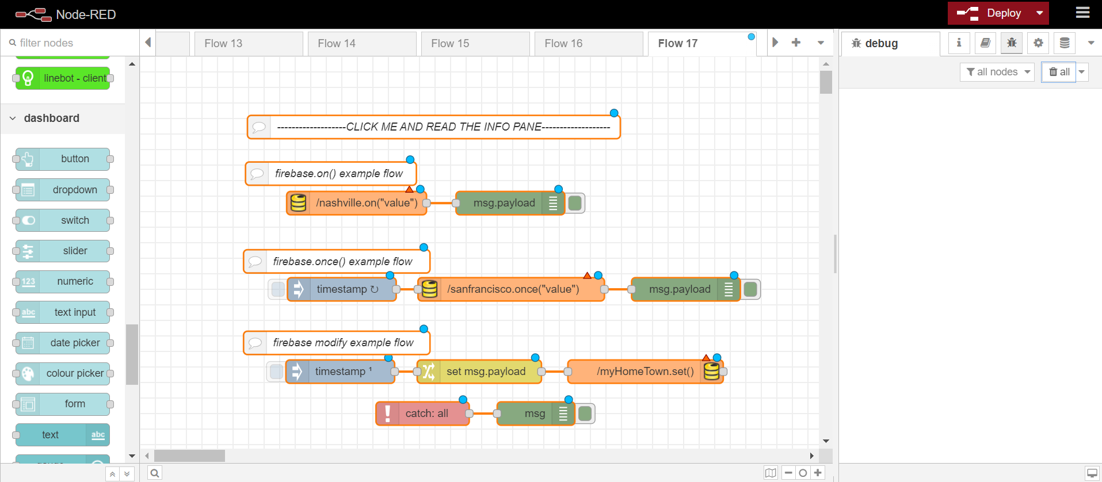

Slide 27
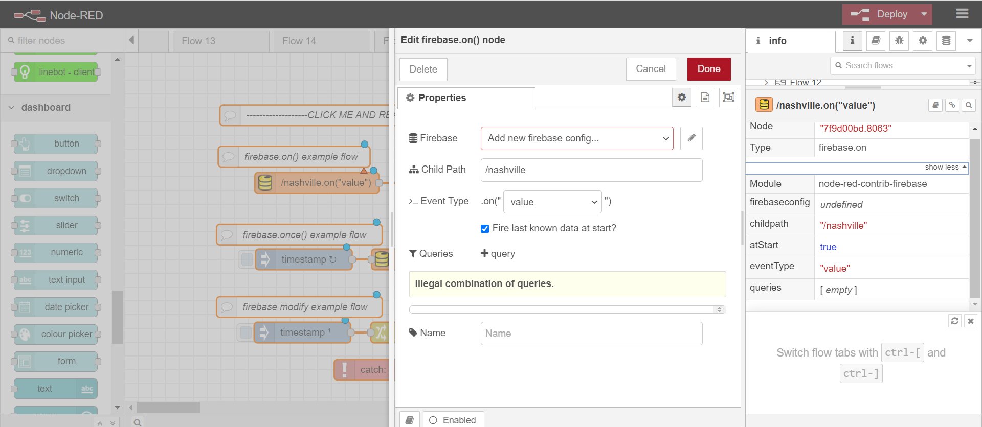

Slide 28
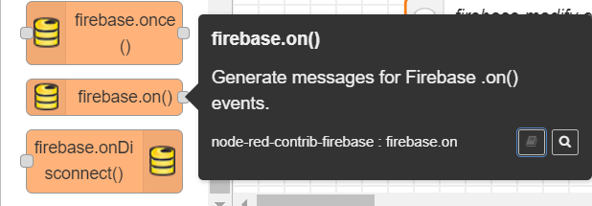
可察看更多資訊

Slide 29
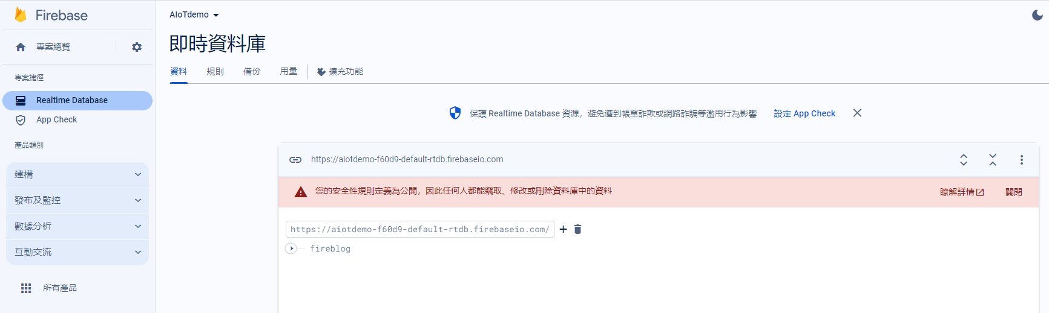
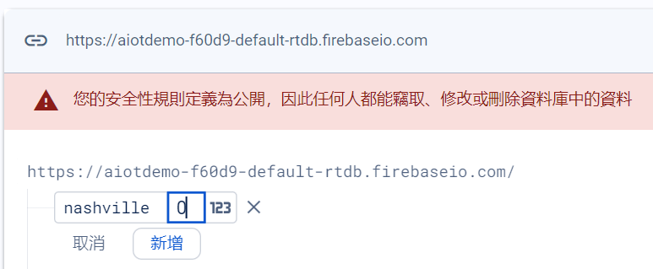
Data

Slide 30
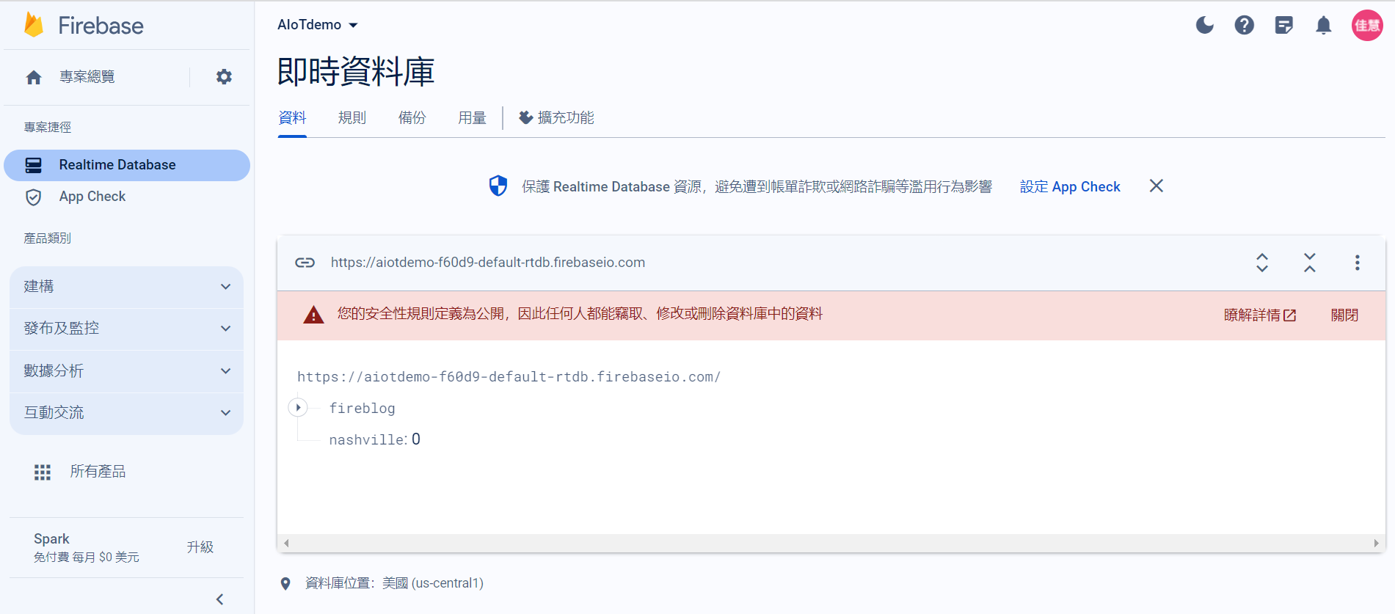
Paste

Slide 31
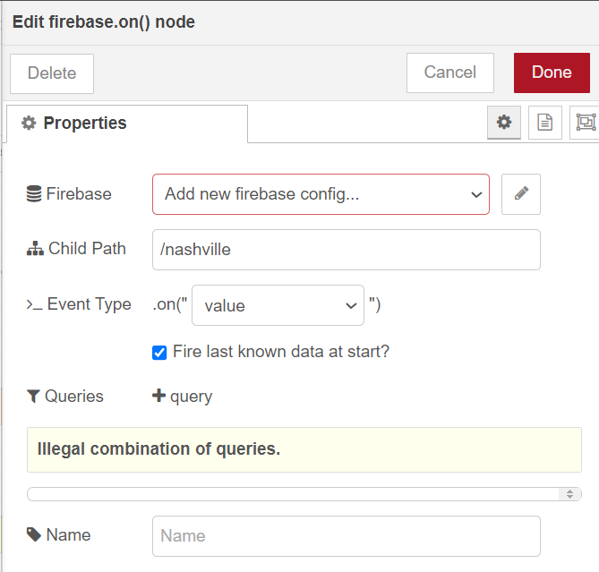

Slide 32
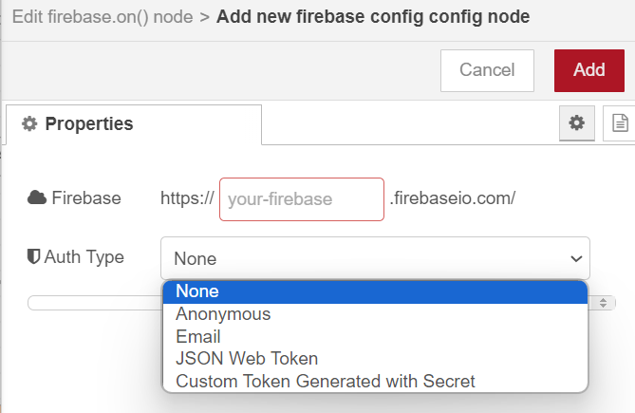
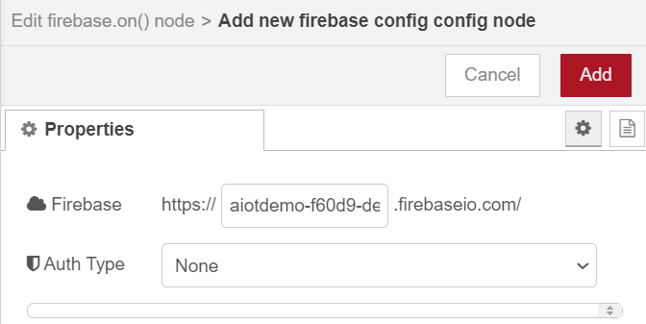
https://xxxxxxxxce-default-rtdb.firebaseio.com/

Slide 33
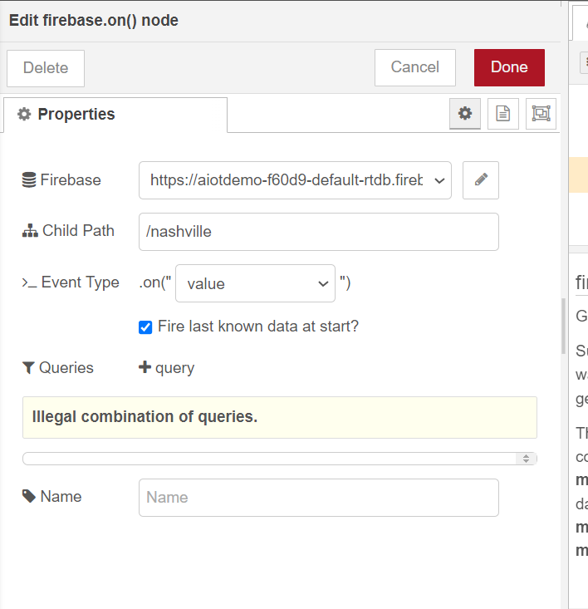

Slide 34
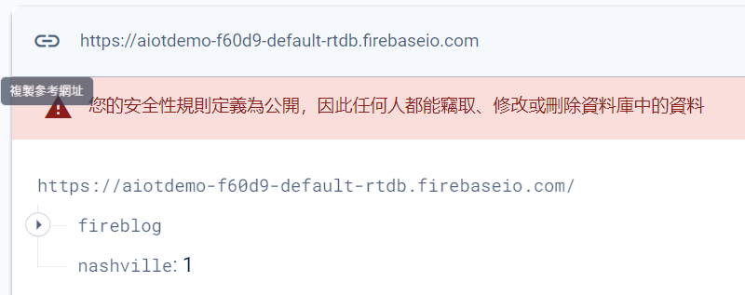
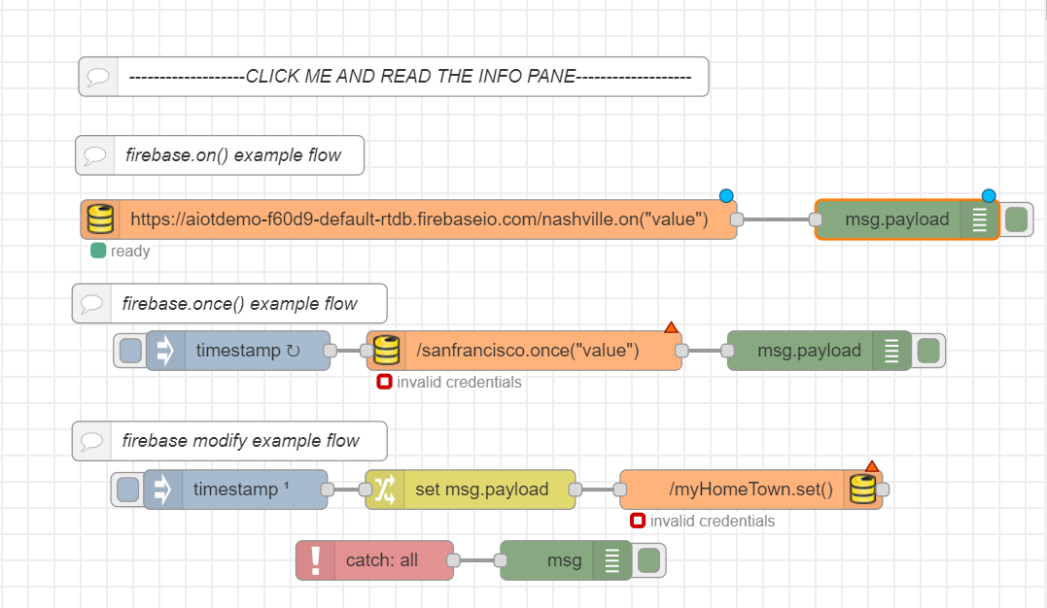
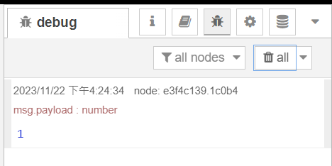

Slide 35
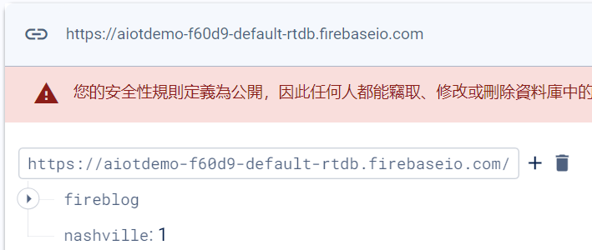
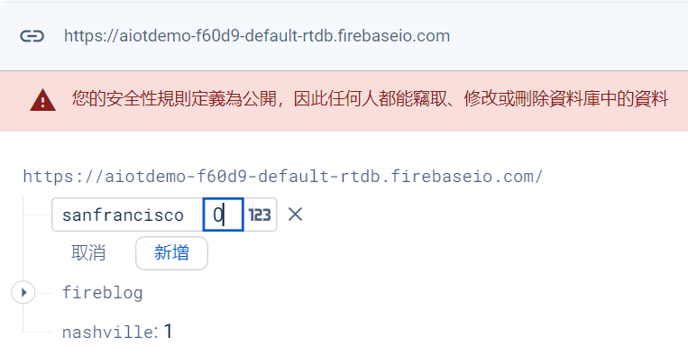
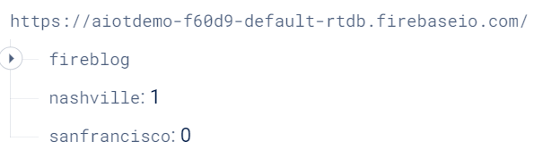
Add

Slide 36




Slide 37


Slide 38


Change the value

Slide 39



Slide 40


Click

Slide 41
Exercise 10-4
Plotly.js

Slide 42


Slide 43
Homework 10-1
Try PATCH and POST methods to write data to your database.
https://firebase.google.com/docs/database/rest/save-data?hl=zh-tw

Slide 44

PATCH
msg.url ="https://aiotdemo-f60d9-default-rtdb.firebaseio.com/fireblog/users/alanisawesome.json";
msg.method = "PATCH";
msg.payload = { "date_of_birth": "June 23, 1912" };
return msg;

Slide 45

並不會因為增加這項內容而替換所有資料

Slide 46

POST
msg.url="https://aiotdemo-f60d9-default-rtdb.firebaseio.com/fireblog/users.json";
// msg.method = "PATCH";
msg.payload={"alanisawesome": {"name": "Jackson", "birthday": "August 23, 2001"}};
return msg;

Slide 47

Unique key

Slide 48

Homework 10-2

Slide 49

msg.url ="https://fornodered-312ce-default-rtdb.firebaseio.com/fireblog.json";
return msg;
Set URL
HTTP GET
click
var result= msg.payload;
var obj=JSON.parse(result);
msg.payload=Object.values(obj);
return msg;
Processing the response

Slide 50


Expand

